Slide 1

FLIPKART SALES ANALYSIS
-By Mythili G

Slide 2
INTRODUCTION
In today’s digital era, e-commerce platforms generate a huge volume of sales data every day. Analyzing this data is essential for understanding customer behavior, sales performance, and business growth.
Flipkart, one of India’s leading e-commerce companies, handles millions of transactions across various product categories, regions, and customer segments.
The Flipkart Sales Analysis project focuses on analyzing sales data using Microsoft Power BI, a powerful business intelligence and data visualization tool.
The main objective of this project is to transform raw sales data into meaningful insights through interactive dashboards and reports.
By visualizing key metrics such as total sales, revenue trends, top-selling products, category-wise performance, and regional sales distribution, stakeholders can make informed business decisions.

Slide 3
PROBLEM STATEMENT
Flipkart generates a large volume of sales data that is difficult to analyze in raw format.
Lack of clear visualization makes it hard to identify sales trends, top products, and regional performance.
This project uses Power BI to transform raw data into interactive dashboards for easy analysis and better decision-making.

Slide 4
Business problem
1.How does revenue vary by product category? 2.How does revenue vary by brand? 3.What is the monthly sales trend based on listing_date?
4.Which products are the top 10 revenue contributors?
5.Which sellers generate the highest revenue? 6.Which seller_city contributes the most to total sales?

Slide 5
Data overview
Product id
Product name
Category
Brand
Seller
Seller city
price

Slide 6
Technology used
Data Source
Flipkart Sales Dataset collected in Excel format containing sales and order details.
Data Preparation & Transformation (ETL)
Power Query is used to clean, transform, and organize the raw sales data.
Data Modeling involves creating tables such as Calendar, Product, Category, and City, and establishing proper relationships between them.

Slide 7
Technology used
Data Analysis & Visualization
Power BI is used for analyzing sales performance.
Various visualizations are created, including Pie chart, Tree Map, Filled Map, Bar chart, Donut chart, Line chart, Funnel chart, .
DAX measures are used to calculate key metrics such as total sales, revenue, and growth trends.
Data Insights & Reporting
An interactive Power BI Dashboard is developed to present clear insights for decision-makers.
Filters and Slicers are applied to analyze sales by category, product, city, month, and payment method.

Slide 8
Data preprocessing
Imported Flipkart sales data from Excel into Power BI.
Verified column structure and corrected data types (Date, Text, Number).
Created new fields such as Month, Year, and Quarter from the order date.
Prepared supporting tables like Calendar, Product, Category, and City
Established relationships between fact and dimension tables for analysis.

Slide 9
Data cleaning
Identified and handled missing or blank values in key columns.
Removed duplicate records to ensure accurate sales calculations.
Renamed columns for clarity and consistency.
Standardized category and city names to avoid mismatch.
Removed unnecessary or irrelevant columns.

Slide 10
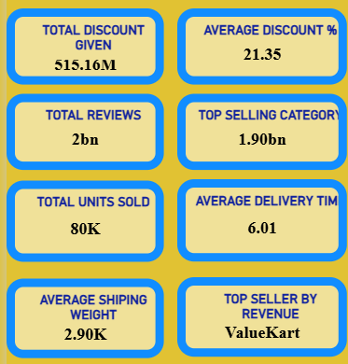
Key metrics and kPI’ s
Total Discount Given
Average Discount %
Total Reviews
Top Selling Category
Top Units sold
Average Delivery Time
Average Shipping Weight
Top Seller by Revenue.

Slide 11
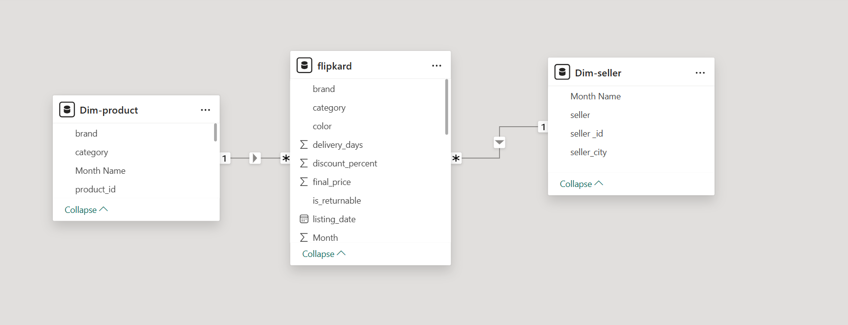
Data modeling overview

Slide 12
Dax measures
DAX (Data Analysis Expressions) measures are formulas used in Power BI to calculate values like Total Sales, Total Orders, Average, Growth, etc.
MEASURES
Total Discount Given = SUM(price − final_price)
Total Reviews = SUM(review_count)
Top Selling Category (by Revenue)

Slide 13
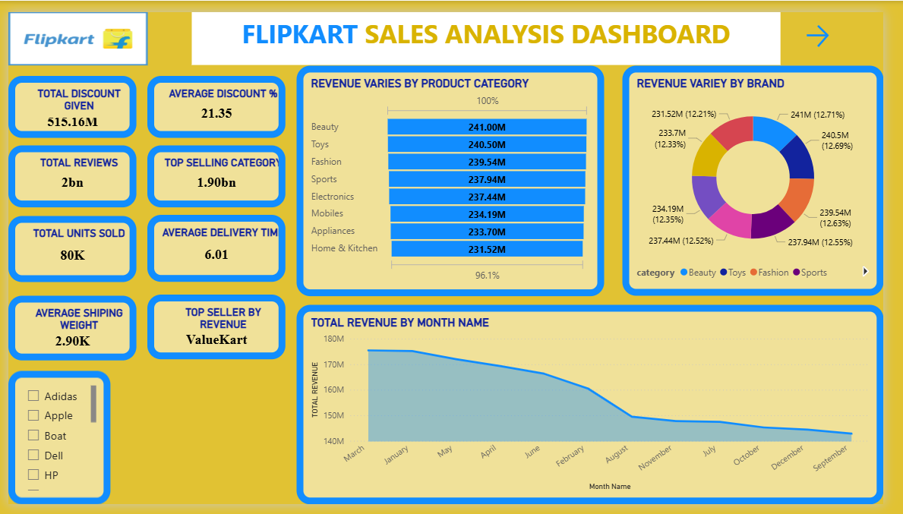
Power bi dash board overview

Slide 14
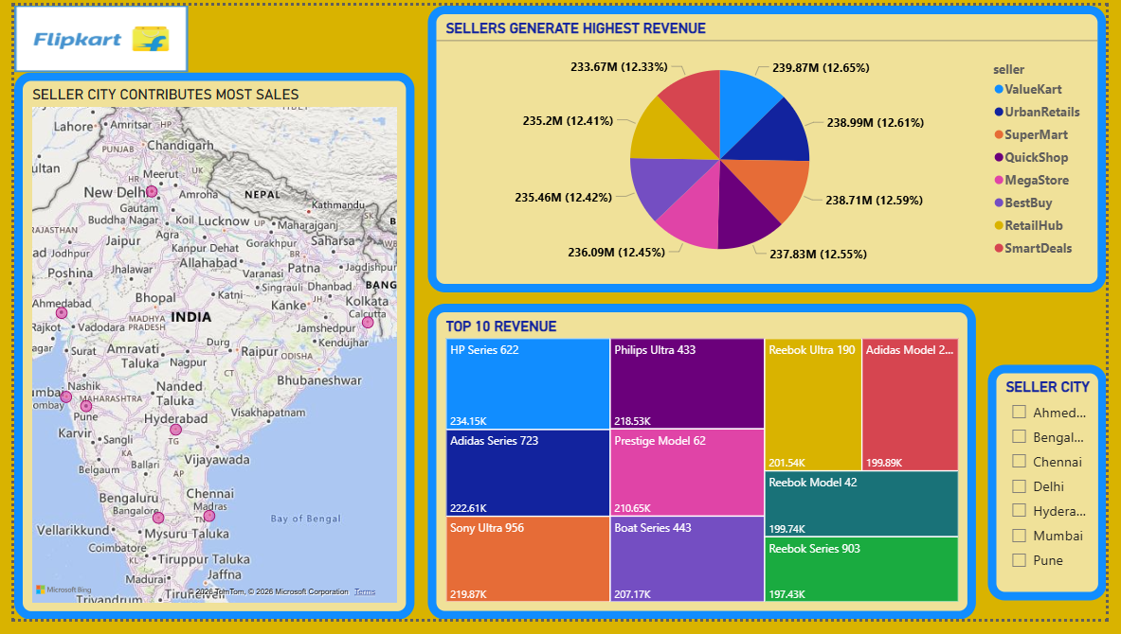
Power bi dash board overview

Slide 15
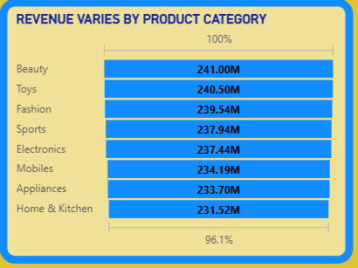
revenue VARIATION BY CATEGORY
Revenue Variation by Category
Use Funnel Chart
Axis → Category
Values → Total Revenue

Slide 16
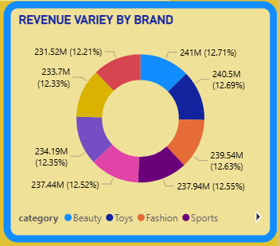
Overall revenue for product brand
Revenue Variation by Brand
Use Donut Chart
Axis → Brand
Values → Total Revenue

Slide 17
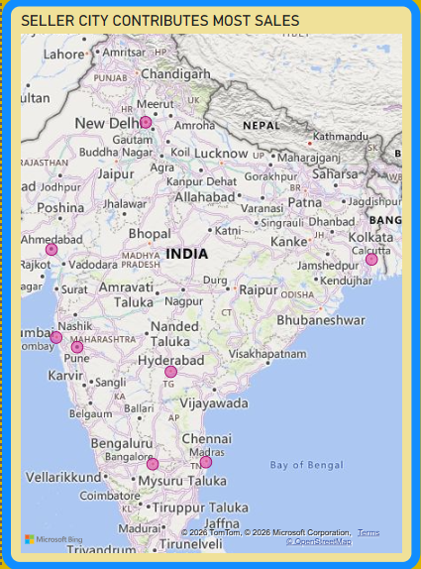
seller_city contributes the most to total sales
Seller City Contributing Most
Insert Map Visual
Location → seller_city
Values → Total Revenue

Slide 18
conclusion
The Flipkart Sales Analysis project successfully demonstrates how raw sales data can be transformed into meaningful insights using Power BI.
Through effective data cleaning, preprocessing, and data modeling, the dataset was prepared for accurate analysis.
Interactive dashboards and visualizations helped in understanding sales trends, top-performing products, category-wise performance, and regional sales distribution.
The use of DAX measures enabled the calculation of key metrics and KPIs, supporting data-driven decision-making.
Overall, this project highlights the importance of business intelligence tools in improving sales analysis and enhancing strategic planning in the e-commerce sector.

Slide 19


